Slide 1
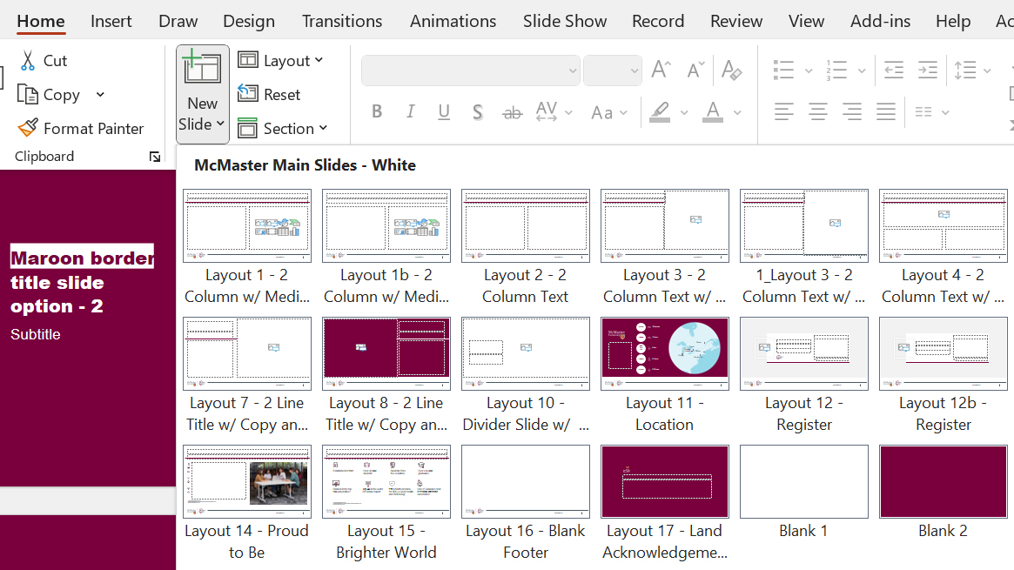
New McMaster PowerPoint Overview
Introduction and Slide Options
This master PowerPoint file contains everything you need to build out presentations using A Brighter World’s new brand standards.
Look through the ”New Slide” menu under the “Home” ribbon in your tool bar:
Within this section, you will find categories for cover slides, information slides with a white background, information slides with a maroon background, and closing slides.

Slide 2
New McMaster PowerPoint Overview Continued
Toolkit and Hidden Slides
We have populated a few of these slides within this deck, so feel free to change and delete as needed.
The back end of the file contains a ”PowerPoint Toolkit” section. This aims to provide additional assets as well as instructions to help use the various items found within.
Instructional slides are “hidden” by default and should be removed before publishing.
Any slide that is marked with this icon should be deleted upon finishing your final presentation.

Slide 3
New McMaster PowerPoint Overview Continued (2)
Accessibility Disclaimer
This PowerPoint template will facilitate the creation of a PowerPoint presentation that meets current Accessibility for Ontarians with Disabilities Act (AODA) compliance guidelines (Web Content Accessibility Guidelines 2.0 AA).
Accessibility instructions that cover the core skills of digital accessibility have been integrated into the Toolkit and combine the use of automated tools and manual checks.
User identities are diverse - you may still receive requests for alternative formats.
Microsoft PowerPoint features may update or be removed after the creation of this template.

Slide 4
Presentation title goes here on up to 3 lines
Subtitle goes here on up to 3 lines

Slide 5
Presentation title goes here on up to 3 lines
Subtitle goes here on up to 3 lines

Slide 6
Land Acknowledgement
McMaster University recognizes and acknowledges that it is located on the traditional territories of the Mississauga and Haudenosaunee nations, and within the lands protected by the Dish With One Spoon wampum agreement.

Slide 7
Pie Chart Example

Slide 8
Line Graph Example
Cannot use light accent colours.

Slide 9
Two Column Text Example

Slide 10
Image Right Example
Test
Test

Slide 11
Centered Image Example

Slide 12
Three Callout Example Layout

Slide 13
Three Callout Example Layout (2)

Slide 14
Three Callout Example Layout (3)

Slide 15
Callout layout example
Test
Top
50
in Health & Medicine in four major international rankings

Slide 16
Callout layout example (2)
Top
50
in Health & Medicine in four major international rankings

Slide 17
Image Left, Text Right Example

Slide 18
Divider slide example title
Subtitle goes here on up to 2 lines

Slide 19
Based in Hamilton, the third largest city in Ontario.
Toronto
45 minutes
Ottawa
5 Hours
Ottawa
New York City
1 Hour
Toronto
McMaster University
Boston
Boston
Chicago
New York City
1.5 Hours
Chicago
1.75 Hours

Slide 20
Name Goes Here (2)

Slide 21
Name Goes Here (3)

Slide 22
The McMaster campus totals 350 Acres
between the Niagara Escarpment and the Royal Botanical Gardens.

Slide 23
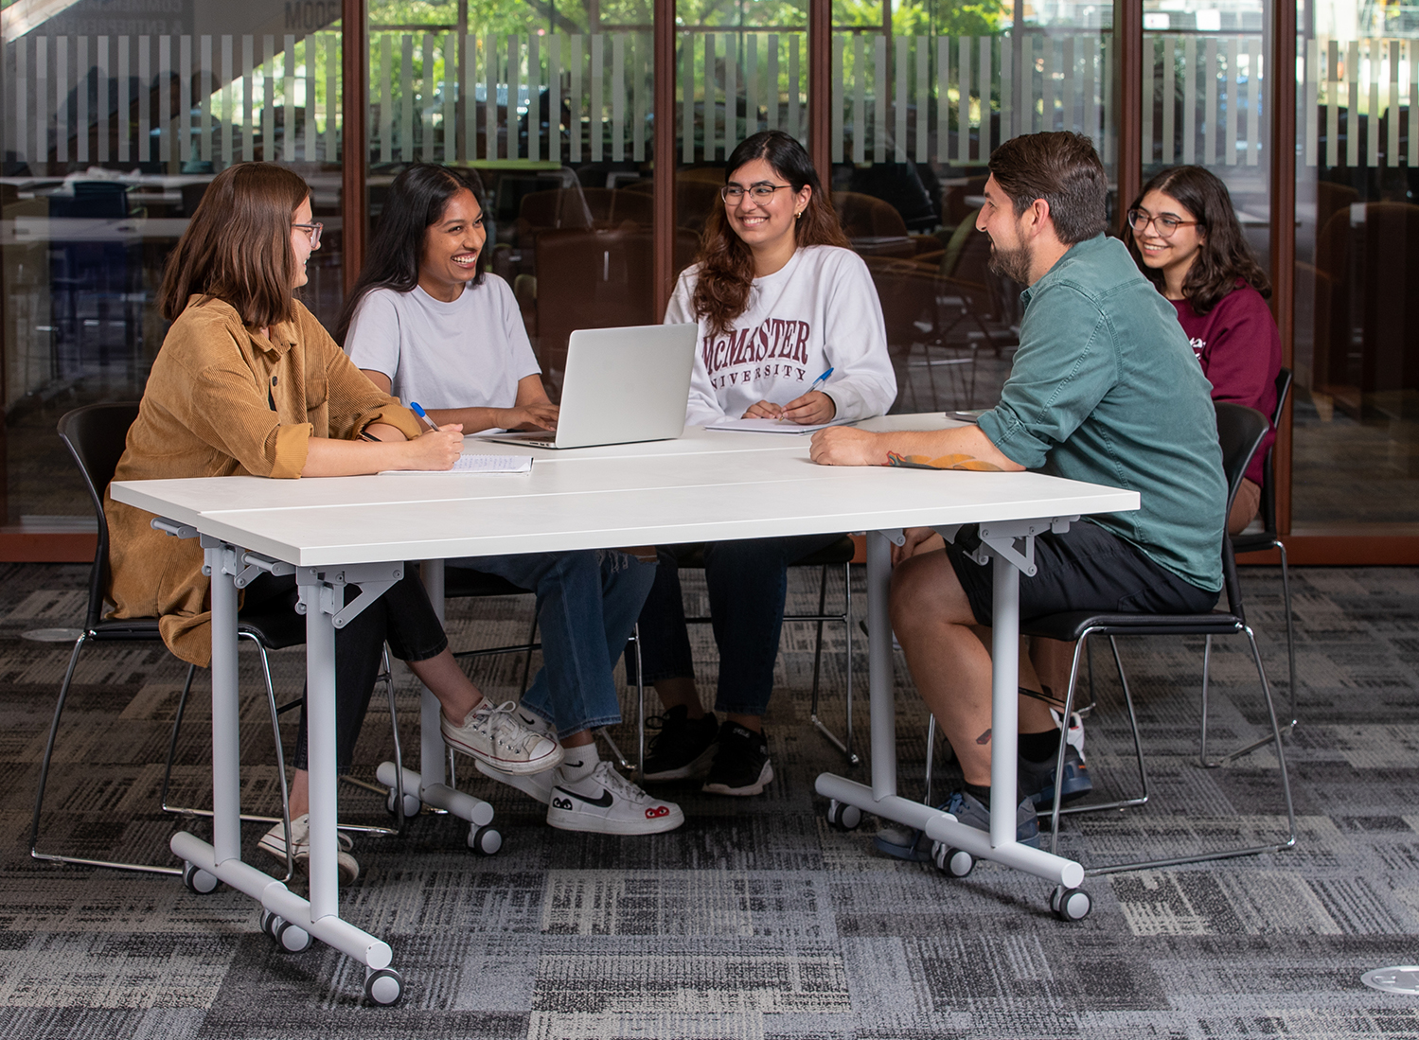
Proud to be a great research & teaching university
At McMaster, our researchers and teachers are committed to creating a Brighter World.
Top 40 in the world for Global Impact*
Ranked among the top‡ 100 universities
1st in North America for SDG 3 Good Health and Well-Being*
Top 40 in the world for Clinical and Health*
One of Canada's most research-intensive universities†
1st in the world for industry impact*
1st in Canada and 75th in the world for Research Quality*
Notes:
Updated February 2024
For updated fast facts, download the latest PowerPoint template or fast fact slides on the Resource Library > Files, Templates & Virtual Backgrounds > PowerPoint Templates
Login: https://brand-resources.mcmaster.ca/asset-bank/action/viewLogin

Slide 24
Creating a Brighter World
Established in 1887
Over 37,500
students
Students from
125 countries
Over 227,000
graduates
Ranked in the top 100 universities‡
Top 40 in the world for Global Impact*
1st in North America for SDG 3 Good Health and Well-Being*
One of Canada's most research-intensive university†
* Times Higher Education 2023
‡ Shanghai Ranking's Academic Ranking of World Universities 2023
† Research Infosource 2023
Notes:
Updated February 2024
For updated fast facts, download the latest PowerPoint template or fast fact slides on the Resource Library > Files, Templates & Virtual Backgrounds > PowerPoint Templates
Login: https://brand-resources.mcmaster.ca/asset-bank/action/viewLogin

Slide 25
Creating a Brighter World (2)
Established in 1887
Over 32,000
students
Students from
125 countries
Over 235,000
graduates
Ranked in the top 100 universities‡
Top 40 in the world for Global Impact*
1st in North America for SDG 3 Good Health and Well-Being*
One of Canada's most research-intensive universities†
* Times Higher Education 2023
‡ Shanghai Ranking's Academic Ranking of World Universities 2023
† Research Infosource 2023
Notes:
Updated February 2024
For updated fast facts, download the latest PowerPoint template or fast fact slides on the Resource Library > Files, Templates & Virtual Backgrounds > PowerPoint Templates
Login: https://brand-resources.mcmaster.ca/asset-bank/action/viewLogin

Slide 26
Thank you!

Slide 27
PowerPoint Toolkit
The following is a set of resources and options for you to build out presentations.

Slide 28
Presentation title goes here on up to 3 lines
Subtitle goes here on up to 3 lines

Slide 29
Presentation title goes here on up to 3 lines
Subtitle goes here on up to 3 lines

Slide 30
Presentation title goes here on up to 3 lines
Subtitle goes here on up to 3 lines

Slide 31
Presentation title goes here on up to 3 lines
Subtitle goes here on up to 3 lines

Slide 32
Presentation title goes here on up to 3 lines
Subtitle goes here on up to 3 lines

Slide 33
Presentation title goes here on up to 3 lines
Subtitle goes here on up to 3 lines

Slide 34
Title Typography Treatment

Slide 35
Brighter World Highlight
Making an impact
If the copy includes a positive benefit or outcome, this can be highlighted using the maroon box typography treatment.
Step 2. From the selection plane, ensure the “BW-TextHighlight” shape is placed underneath the text you would like to highlight.
Presentation title goes here on up to 3 lines
Step 1. Create a rectangle shape slightly larger than the words you are highlighting.
As a general guide, the space between the top, left, and right of the letters and the outside edge of the box should be the approximate thickness of a vertical bar in the letters. The space below the letters should be about double, to account for descending letters.
P
Use the Reading Order pane (Accessibility – Reading Order Pane) or Selection Pane (Home – Arrange – Selection Pane) to move the box behind the copy. It should go above other design elements on the slide, including gradients or circles.

Slide 36
Image Selection and Title Slide Guidelines

Slide 37
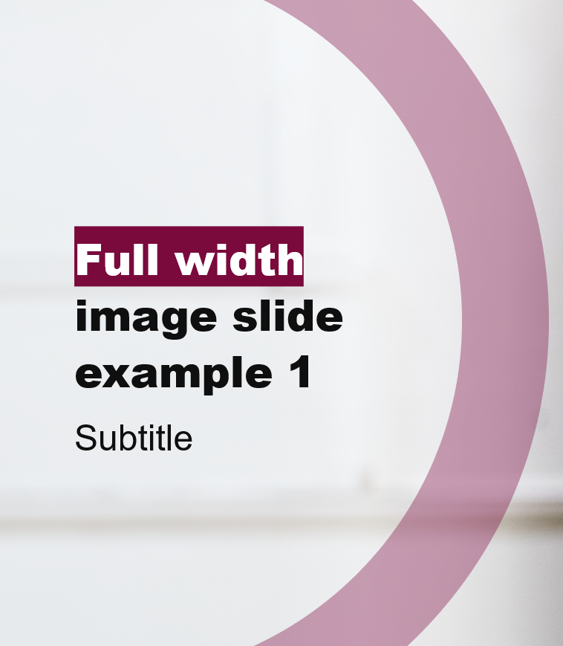
On-Image Colour Contrast
Tools to help
When selecting images to use for your title slides and break page slides, colour contrast of your text on top of the image needs to be taken into consideration.
The following slides will cover a range of options available to help produce results that adhere to WCAG guidelines.
This is an example of good contrast.
This is an example of insufficient contrast.

Slide 38
Choosing images for Title Slides:
Option 1 – Natural Image Contrast (preferred)
The optimal choice for image selection is an image that has sufficient contrast on its own. This way the Brighter World branded title treatment can be applied with no additional assistance. To learn how to verify if the colour contrast meets compliance, visit the Colour Contrast section later in the toolkit.

Slide 39
Choosing images for Title Slides (2):
Option 2 – Solid Colour Box
Knowing that not all images are created equal, we have included an option to leverage a white solid colour shape to ensure optimal contrast. These shapes are a part of the branding guidelines and a great addition to the toolkit.
Presentation title goes here on up to 3 lines
NOTE: We have created this pre-made lock up to be used. It has been named and ordered properly in the selection plane.
Please copy and paste it when you need to utilize this in your layout.
Subtitle goes here on up to 3 lines

Slide 40
Choosing images for Title Slides (3):
Option 3 – Gradient Overlay
The overlay is designed in a way to focus only on the area of text you’d like to add contrast to.
As a rule of thumb, when choosing a photo for your title slide, prioritize images that have negative space (no points of interest) on the lefthand side. This way we can avoid placing the gradient overlay on top of subjects and leave the focal point of the image clear and concise.

Slide 41
Brighter World Circle
How to use the circle for emphasis.

Slide 42
First option for implementation:
PowerPoint Shape Version
Brighter World Circle – PowerPoint Shape Version
Copy and paste this circle element to use on your slides.
If using as an overlay on an image, transparency should be set to 65%.
To learn how to edit PowerPoint shapes, please visit this page.
Avoid overlapping the circle element with individuals in the photo you have selected.
Use the Reading Order pane (Accessibility – Reading Order Pane) or Selection Pane (Home – Arrange – Selection Pane) to move the circle behind layers. It should go above the image and any gradient on the slide, but under the text highlight and text.
Note: The Brighter World circle assets have been pre-marked as “decorative” for descriptive purposes.

Slide 43
Second option for implementation:
PNG Shape Version
Brighter World Circle – IMG/PNG Version
Copy and paste this circle element to use on your slides.
If using as an overlay on an image, transparency should be set to 65%.
Use the Picture Format – Crop tool to adjust the circle’s size.
Avoid overlapping the circle element with individuals in the photo you have selected.
Use the Reading Order pane (Accessibility – Reading Order Pane) or Selection Pane (Home – Arrange – Selection Pane) to move the circle behind layers. It should go above the title image and any gradient on the slide, but under the text highlight and text.
Note: The Brighter World circle assets have been pre-marked as “decorative” for descriptive purposes.

Slide 44
Icons

Slide 45
Updated McMaster Icons
NOTE: For more icons, please visit Resource Library > Icons
After editing, flatten the icon before adding to your slide.

Slide 46
Accessibility
How to create an inclusive presentation.

Slide 47
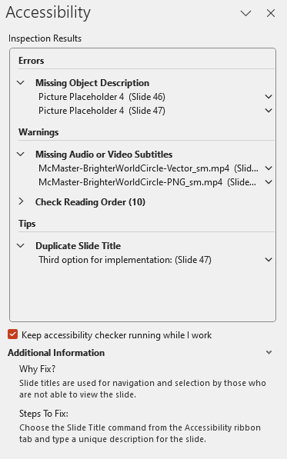
How do you check the accessibility of your presentation?
Automatic Testing using the Accessibility Checker
Microsoft PowerPoint has implemented numerous accessibility features to facilitate the creation of inclusive content within the software. The Accessibility Checker (Review – Check Accessibility) should always be referenced while creating your PowerPoint. It will identify any accessibility issues that can be automatically detected and should be referenced throughout creation.
Errors are issues that need to be remediated.
Warnings are issues that need manual verification.
Tips are helpful recommendations for accessibility.
You may not need to fix all inspection results, please review the checker manually before completing your slides.

Slide 48
How do you check the accessibility of your presentation? (2)
Manual Testing for Accessibility
Using the Accessibility Checker tool is a fantastic start to creating accessible content. Manual testing will always be required to verify if your content is compliant to WCAG 2.0 AA standards.
This guide will reference specific methods or tools that help facilitate the creation of inclusive content, including those for reading order and colour contrast.

Slide 49
Accessible Document Structure

Slide 50
Accessible Document Structure – Slide Titles
Make your PowerPoint Navigable for Everyone
For your presentation to be accessible for everyone, including those using assistive technology like a screen reader, it is essential that you utitlize the built-in features within PowerPoint found within this template.
Slide titles should never be removed as they allow for quick navigation and wayfinding in your presentation.
To verify if your slide has a title, use the Accessibility Checker and/or the Outline View (View – Outline View) to review the titles and content order for each slide.
Please also rename the title of your document from the default (File – Info – Title).

Slide 51
Accessible Document Structure – Reading Order
Make your PowerPoint Navigable for Everyone
Reading order can be the most impactful aspect of a presentation in terms of accessibility.
Visual users rely on the arrangement of graphic elements and text on a slide to interpret what should be read in what order.
For those who cannot interpret the slide visually and/or who use assistive technology, the reading order of the slide must be verified.
By default, placeholder elements within this template have been created to have a logical reading order.
Items added to the template will require manual verification for reading order (please see next slide) and are typically added to the top, or last, of the reading order.

Slide 52
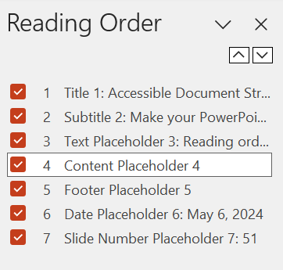
Accessible Document Structure – Reading Order (2)
Make your PowerPoint Navigable for Everyone
Reading order can be verified two ways using a Windows machine and one way using a Mac OS device.
Selection Pane (Windows and Mac) – this method uses Z Order, or bottom to top. It can be accessed via Home – Arrange – Selection Pane. Items can be rearranged in this panel so that the reading order is preserved.
Reading Order Pane (Windows) – Accessed via Review – Check Accessibility – Reading Order Pane – this method is an intuitive approach to verify when content will be read aloud for users. Items can be rearranged in this panel so that the reading order is logical.

Slide 53
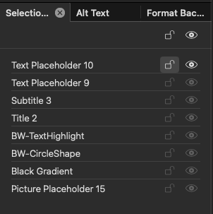
Accessible Document Structure – Reading Order (3)
Make your PowerPoint Navigable for Everyone
Information in PowerPoint is read from the bottom of the selection plane to the top. As a note when designing keep in mind the order in which the information should be read. Below is an example that follows this logic:
2
4
5
3
1
8. Date
7. Presenter Name
6
6. Slide Subhead
5. Slide Title (this will be the first item read)
7
4. Text Highlight (marked as decorative)
3. Circle Shape (marked as decorative)
8
2. Gradient Overlay (marked as decorative)
NOTE: Items marked as “decorative” will not be picked up by assistive technology.
1. Background image (marked as decorative)

Slide 54
Font Use and Text Formatting
Using McMaster Fonts and Formatted Text
This PowerPoint template uses Arial, a McMaster font, which is accessible for individuals in digital contexts.
When copying content from another location, we recommend using the Keep Text Only option for paste formatting.
Text can be bolded for emphasis.
Font size should be as large as possible in content areas for legibility when presenting.
Line and paragraph spacing should not be reduced from the template default whenever possible.
Lists must be created using the bulleted or numbered lists tool (Home – Paragraph) so that individuals using assistive technology will be told it is a list when interacting.
Lists should not be created using unformatted symbols. Symbols can be changed in the Bullets and Numbering menu.

Slide 55
Hyperlinks or URLs

Slide 56
Accessible Hyperlinks or URLs
How to Equitably Connect to other Content
Hyperlinks within a PowerPoint should follow these four principles:
Are the only underlined text in your presentation.
This ensures visual users are immediately able to identify that it is a link.
Are descriptive.
The user should be able to understand the purpose of the link based on the hyperlinked text.
Are unique.
Different links should never use the same formatted text. A common example is the use of “Learn More” several times within a document.
Are not left unformatted.
Links can easily become long and difficult to understand for those using assistive technology.
Accessible link examples:
Visit the McMaster Brand website for resources for McMaster branding.​
Email brandmrk@mcmaster.ca with questions about McMaster branding.
Inaccessible link examples:
The old McMaster brand guidelines can be found at this link, but should no longer be referenced: https://brand.mcmaster.ca/app/uploads/2019/04/digital-guidelines.pdf

Slide 57
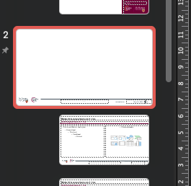
Change the URL in the footer
Make this presentation your own
Below is an outline on how to change the URL in the footer of this presentation:
Step 1: Navigate to the “VIEW” ribbon and select “SLIDE MASTER”
Step 2: From the slide thumbnails on the left, navigate the title slide for the slide masters: “McMaster Main Slides – White”

Slide 58
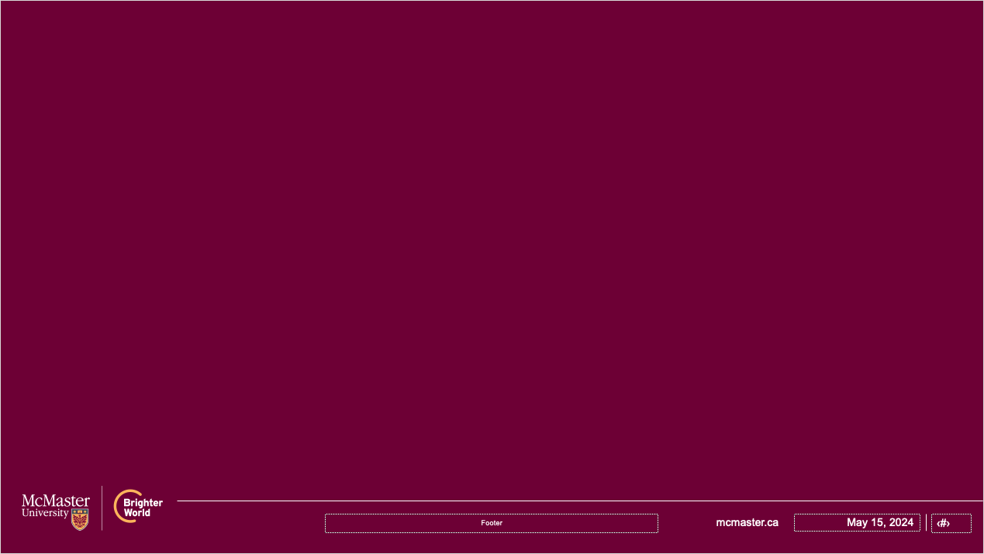
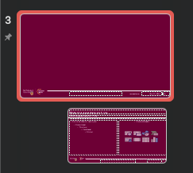
Change the URL in the footer (2)
Make this presentation your own
Step 3: On this title slide you will be able to access and edit the URL
Step 4: You will also need to find the “McMaster Main Slides – Maroon” title slide in the masters and do the same thing.

Slide 59
Alternative Text in PPTx

Slide 60
Alternative Text
Creating text alternatives for visual content.
Alternative (alt) text can be one of the most difficult skills to implement in any digital content creation.
The accessibility checker will notify you if alt text is missing or if it has been automatically generated.
It is crucial that you manually verify the alt text of all visual elements you have added to image placeholders or in addition to the template.
At this time, automatic checking tools are not able to check if the alternative text is logical or contextualized. This may change with the adoption of AI tools into the Microsoft ecosystem.
Decorative visual elements can also be watermarked into the slide template using the Slide Master view.

Slide 61
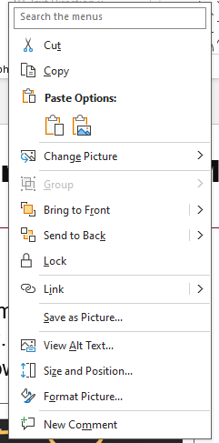
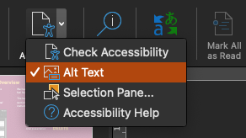
Accessing the Alternative Text Menu
Two Methods
Using the Accessibility Checker:
Select the Review tab in the home ribbon menu and select Check Accessibility.
Select Alt Text from the drop down to open the Alt Text side bar.
From the visual element:
Right click on an image or graphic.
Select View Alt Text from the menu.

Slide 62
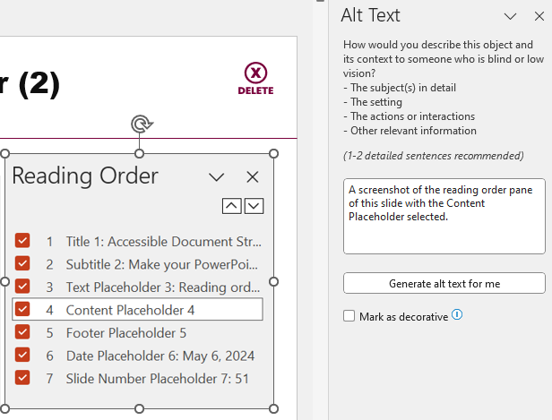
Creating Meaningful Alternative Text
How to Determine What is Needed for your Presentation
Creating meaningful alternative text can be difficult. There are three questions you can ask to make the process easier and to creating meaningful alt text:
Start: Is this image being used for visual decoration?
Yes: This image can be marked decorative in the Alt Text window.
No: Can this image be described in one (1) to two (2) sentences?
Yes: Use the alternative text panel to add your alternative text.
Your alternative text should answer “Why was this image included in my presentation?”
Unless relevant, avoid saying “A photo of,” etc.
No: Proceed to the next slide for Complex Images.

Slide 63
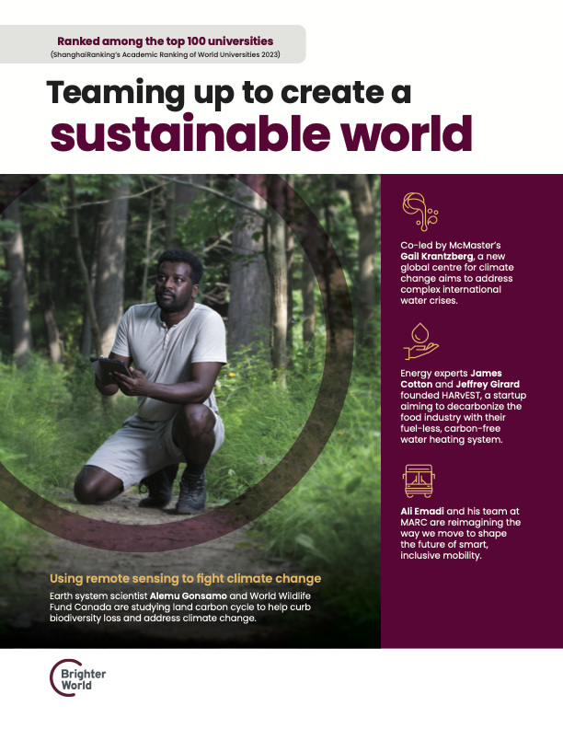
Creating Alt Text for Complex Images
How to Describe Complex Visual Components
Complex images cannot be described in one (1) to two (2) sentences and must provide additional visual description that is too long for the alt text field.
Complex images can include visuals such as event posters, diagrams, and infographics.
Reference the presence of a longer description within the alt text window.
Example: An event poster for the 2024 Solar Eclipse at McMaster University. A full description can be found in the slide notes.
This longer description should contain all relevant information and/or links if QR codes are present.
Visual descriptions should be integrated into your presentation, or vocalized, for in-person presentations.
Notes:
Poster description:
Poster has an individual kneeling in the forest conducting field work.
Ranked among the top 100 universities
(ShanghaiRanking’s Academic Ranking of World Universities 2023)
Teaming up to create a sustainable world Co-led by McMaster’s Gail Krantzberg, a new global centre for climate change aims to address complex international water crises.
Energy experts James Cotton and Jeffrey Girard founded HARvEST, a startup aiming to decarbonize the food industry with their fuel-less, carbon-free water heating system.
Ali Emadi and his team at MARC are reimagining the way we move to shape the future of smart, inclusive mobility.
Using remote sensing to fight climate change Earth system scientist Alemu Gonsamo and World Wildlife Fund Canada are studying land carbon cycle to help curb biodiversity loss and address climate change.
Brighter world logo.

Slide 64
Flattening Complex Images before Adding Alt Text
A Useful Tool for Grouped Images
In order to improve the user navigation experience for those using assistive technology, it is recommended that you create a “flattened” image of any complex visuals before adding alternative text.
These include, but are not limited to, smart art generated in PowerPoint, charts, graphs, and layered images.
This flattened image can be created by taking a screenshot of your visual element or saving a PowerPoint slide as a JPG.
It is recommended to keep the source file of your design element saved separately so you can make changes in the future if needed.

Slide 65
Creating Visual Descriptions of People
Equitably Describing Diverse Populations
If you know the individual and/or it is important to describe their visual appearance:
Image description 1 - more descriptive: Nell, a white woman with short black hair, is outside on a bright day. She wears thick, black-rimmed glasses and smiles at the camera. She also wears a white and dark-coloured quatrefoil collared shirt and a black and gold diagonal stripe bow tie. ​
Image description 2 - less descriptive: A picture of Nell outside smiling at the camera. ​
If you don’t know the person: ​
Image description 1 - more descriptive: Nell, a light-skinned person with short black hair, is outside on a bright day. They wear thick, black-rimmed glasses and smiles at the camera. They also wear a white and dark-coloured quatrefoil collared shirt and a black and gold diagonal stripe bow tie. ​
Preferred Alternative text image description 2: A portrait of Nell.
Taken from: American Anthropological Association “Guidelines for Creating Image Descriptions”
Human Portrait of Nell

Slide 66
Colour Contrast in PPTx

Slide 67
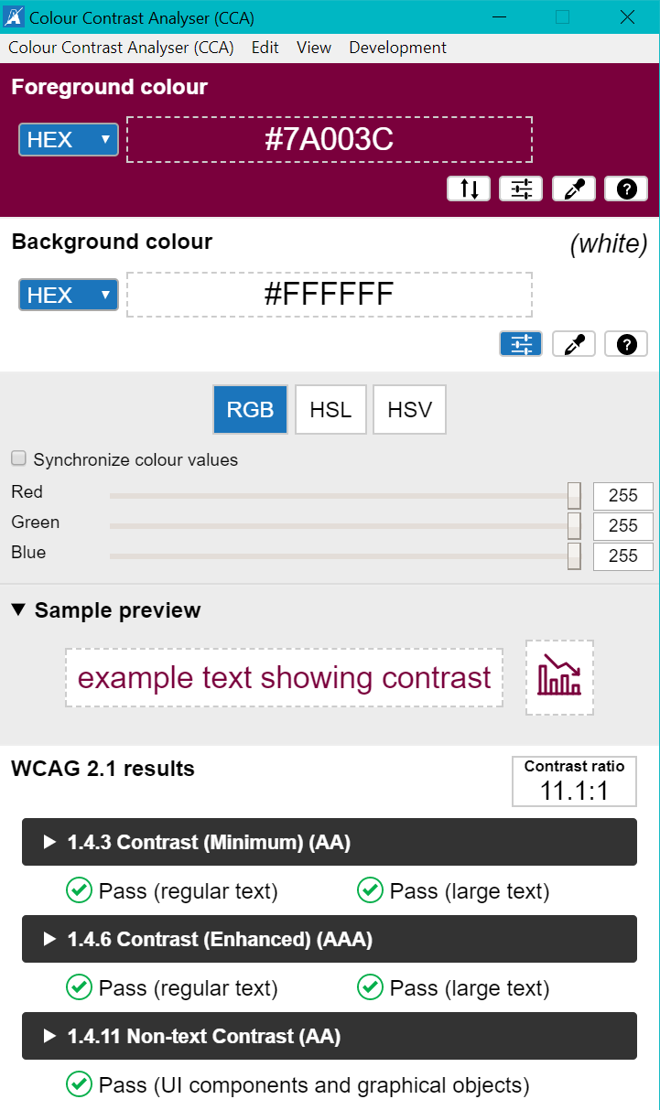
Colour Contrast
How to Check Colour Contrast in your Presentation
Sufficient colour contrast, or the difference between adjacent colours, is crucial for creating an equitable visual experience.
When creating your presentation, it will be necessary to manually check colour contrast when overlaying visual elements.
We must meet a minimum colour contrast for text and visual elements. It is recommended to aim for AAA compliance whenever possible for maximum accessibility of your content.
You can check colour contrast using free tools such as Colour Contrast Analyser (application with colour dropper) or by inputting hex codes into contrast checkers such as Color.Review.

Slide 68
McMaster Colours’ Contrast Values
WCAG 1.4.6 Contrast (Enhanced) AAA – on White
Heritage Maroon (7A003C): 11 (HM Pass AAA Headers, AAA Text)​​
Heritage Gold (FDBF57): 1.6 (HG Fail)​​ - Example
Heritage Grey (495965): 7.2 (HGr Pass AAA Headers, AAA Text)​​
King’s Forest Green (0E5B3D): 8.1 (KFG Pass AAA Headers, AAA Text) ​​
Bayfront Blue (0D5D78): 7.3 (DG Pass AAA Headers, AAA Text) ​​
Dundurn Grey (DBDBDD): 1.3 (DG Fail) - Example
WCAG 1.4.6 Contrast (Enhanced) AAA – on Black
Heritage Gold (FDBF57): 12.7 (HG Pass AAA Headers, AAA Text)​​ - Example
Royal Botanical Pink (FF9980) – 10.1 (RBP Pass AAA Headers, AAA Text) - Example
Cootes Paradise Green (E4EA6C) – 10.1 (CPG Pass AAA Headers, AAA Text) - Example
Albion Falls Blue (AAD5E1) – 13.3 (AFB Pass AAA Headers, AAA Text) - Example
Pier 4 Purple (CC99CC) – 8.9 (P4P Pass AAA Headers, AAA Text) - Example
If conveying meaning, these colours cannot be used on white without a border or drop-shadow.

Slide 69
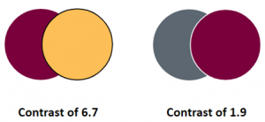
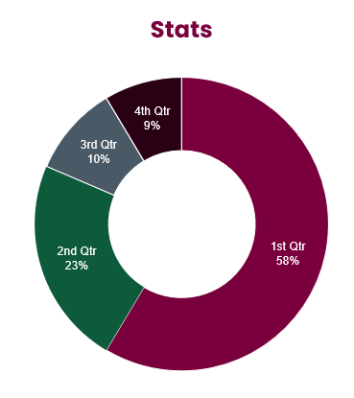
Additional Colour Contrast Considerations
Evaluating Non-text Contrast and Use of Colour
Evaluating Non-text Contrast (WCAG 1.4.11)
Non-text contrast refers to adjacent colours within graphics that are critical to the portrayal of information and must be a minimum of 3:1.
Borders are a great method to increase colour contrast between visual elements.
Use of Colour (WCAG 1.4.1)
Colour cannot be used by itself to convey meaning. This is most frequently seen with charts and graphs that use colour legends.
If using colour, it must be combined with additional visual information, such as labels or symbols, that also meet colour contrast requirements.
For example, a pie chart must have labelled sections that are legible.

Slide 70
McMaster Colours
Heritage and Accent Colours
Heritage Colours
Heritage Maroon
#7A003C
Heritage Gold
#FDBF57
Heritage Grey
#495965
Accent Colours
Royal Botanical Pink
#FF9980
Cootes Paradise Green
#E4EA6C
King’s Forest Green
#0E5B3D
Bayfront Blue
#0D5D78
Albion Falls Blue
#AAD5E1
Pier 4 Purple
#CC99CC
Dundurn Grey
#DBDBDD

Slide 71
Tables, Charts, and Graphs

Slide 72
Accessible Tables
Tables are a great way of displaying data but should not be used to visually structure your slides.
Tables should be simplified whenever possible to include one header row and/or column.
Tables should be visually accessible (contrast).
Tables should have the Header Row and/or First Column checkboxes selected in the Table Design – Table Style Options menu.
Tables should be briefly summarized using the alternative text field.
Brand Resource | File Type
PowerPoint | .pptx
Letterhead | .docx

Slide 73
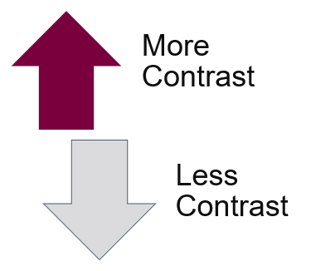
Charts, Graphs and Smart Art
Accessibility Considerations
Charts and graphs that are used to present data must be visually accessible and have alternative text.
Many default chart and graph designs use colour to convey meaning and must be altered before presenting by adding data labels.
Any overlayed text on graphic elements must have sufficient colour contrast.
Charts, graphs, and smart art can also be flattened before embedding to make adding alternative text easier. Navigating grouped items with assistive technology can be difficult.
Shape outlines are a great way to add contrast when needed, for example, a darker border.

Slide 74
Audio and Video

Slide 75
Audio Content
All embedded audio within a PowerPoint file must have captions available.
These captions can be automatically generated.
Macvideo.ca is a fantastic location for audio and video uploads at McMaster that creates 95% accurate captions in most cases.
If your resource is being re-used and/or is public facing, consider editing the captions to be 100% accurate or having it professionally captioned.
Automatic captions are not as accurate when transcribing accented language or other languages.
Podcasts need a transcript to be accessible to Deaf-Blind, Deaf, and hard-of-hearing.
Captions and transcripts also increase accessibility for those who are English Second Language speakers.
“Burned-In” or “Open” captions are not typically recommended as they cannot be edited in the future or adjusted to meet visual accessibility needs.

Slide 76
Video Content
If content you are sharing does not already have captions, consider the following:
When creating video content, where possible:
Consider writing a script – this will help with auto-captioning accuracy, improve recording efficiency and can double as a transcript.
Consider including in your script audio descriptions of what is visually taking place on the screen. This is called Interpreted Description and can reduce the need for described video accommodations.
Resources
Use YouTube to convert a script into a caption file. (Auto-sync function).
Convert caption files from SRT to VTT.
Convert caption files from VTT to SRT.
Type of Video | Options
Videos that are shared​​ | Replace videos with others that have good captions​​ Ask the owner of the video (e.g. YouTube) to caption their content​​
Videos that you create / own​​ | Upload your content to a platform that allows for auto-generated captions and edit where needed​​

Slide 77
Writing Considerations

Slide 78
Writing Considerations for Inclusive Content
Using Plain and Inclusive Language
When preparing content for your presentation please consider the following:
Keep it clear and concise: Avoid jargon and technical terms unless absolutely necessary. Use bullet points and short, easy to digest sentences to make your points.
Emphasize empathy: Imagine your audience is unfamiliar with the topic. Explain concepts clearly and provide context for complex ideas to ensure everyone can follow along.
Prioritize visuals: Use images, graphs, and charts to illustrate your points rather than relying heavily on blocks of text.
Provide additional resources: Include links to websites, articles, or videos where people can learn more about the topic and gain a deeper understanding.

Slide 79
Resource Links

Slide 80
Additional Accessibility Resources for Microsoft PowerPoint
Design: Consider design elements and their impact on accessibility. Simplicity is best. Incorporate ‘white space’ and large (min.18 points) sans-serif fonts, use high contrast (see next bullet point), colour with indicators (more below), and ensure your writing style and language is clear and concise.
Contrast: Colour Tools include a colour contrast checker at webaim.org or ContrastChecker.com, as well as the Colour Contrast Analyser tool. Colour Oracle is a colour blindness testing tool.
Layouts and Templates: Learn to use predetermined layouts for accessible slide presentations (YouTube University of Minnesota, 6:42).
Text Boxes: Learn to add alt-text to text boxes in PowerPoint (YouTube University of Minnesota, 1:36).
Reading Order: Learn to build slide content in proper reading order so screen readers read it correctly (Microsoft Video, 2:29), and how to use the ‘reorder objects’ option in PowerPoint (YouTube University of Minnesota, 1:30).
Alt-Text: Learn to improve image, charts and graphic accessibility in PowerPoint (Microsoft Video, 2:40).
Colour: Learn to use more accessible colours and styles in presentation slides to improve accessibility (Microsoft Video, 2:17).
Clarity: Learn to make presentations clearer and easier to comprehend for everyone (Microsoft Video, 3:50).
Alternative Formats for Distribution: Learn to save a presentation in an alternate format that can be read by a screen reader (Microsoft Video, 3:50).
NOTE: To access the material, right click on the link and select ‘Hyperlink > Open Hyperlink’.
Notes:
Resource Library > Files, Templates & Virtual Backgrounds > PowerPoint Templates

